Slide 1
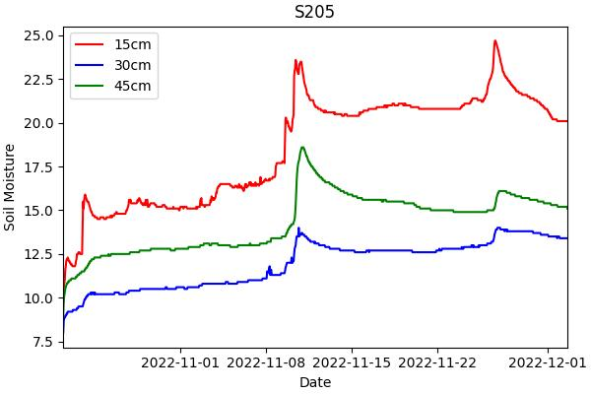
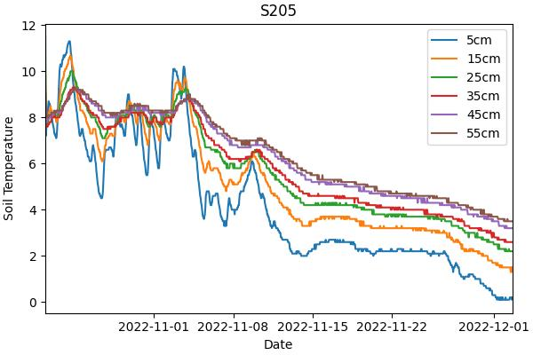

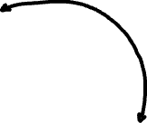
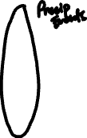


Slide 2
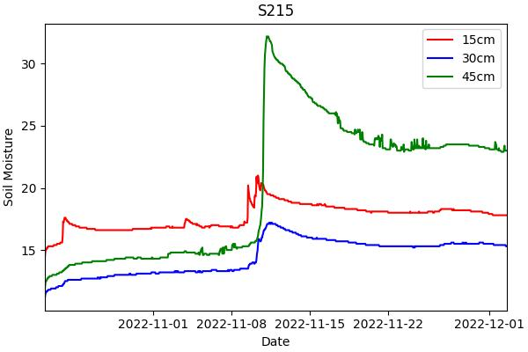
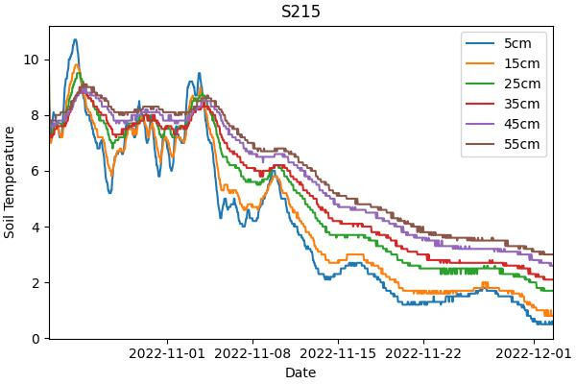


Slide 3
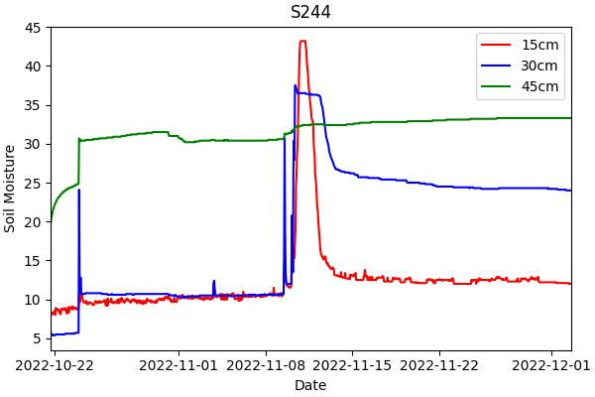
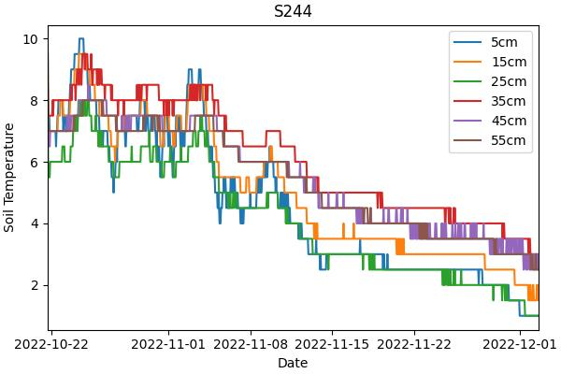



Slide 4
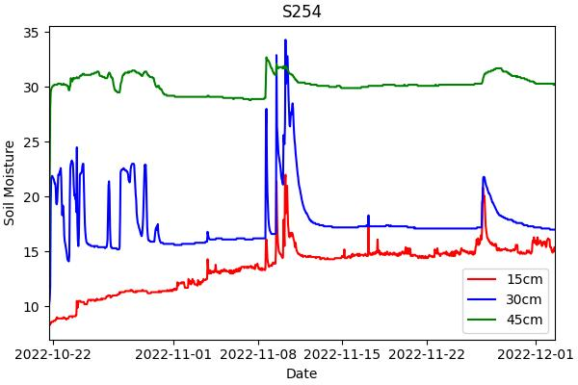
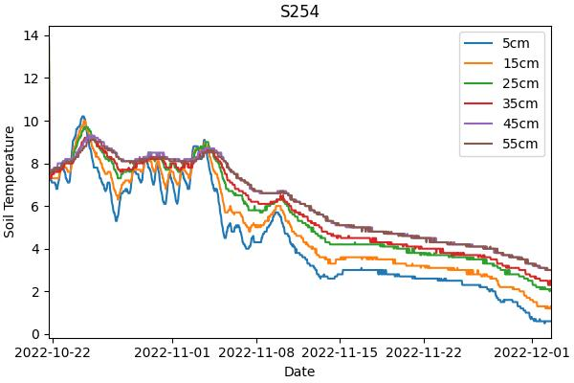




Slide 5
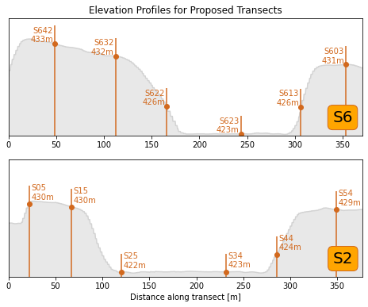

Slide 6





Slide 7
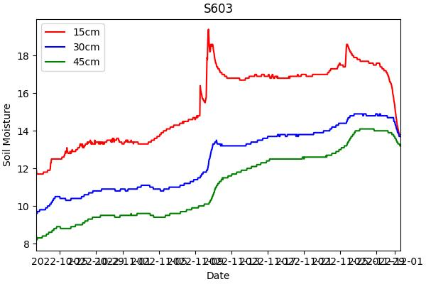
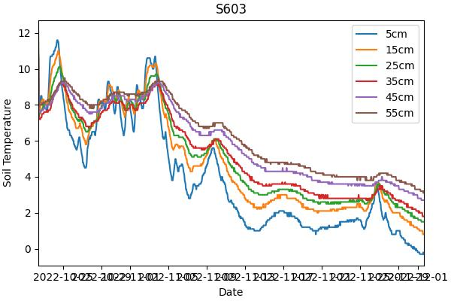



Slide 8
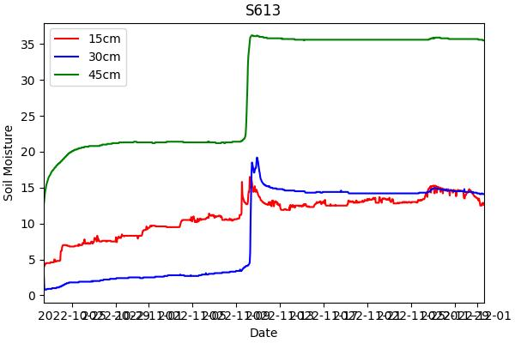
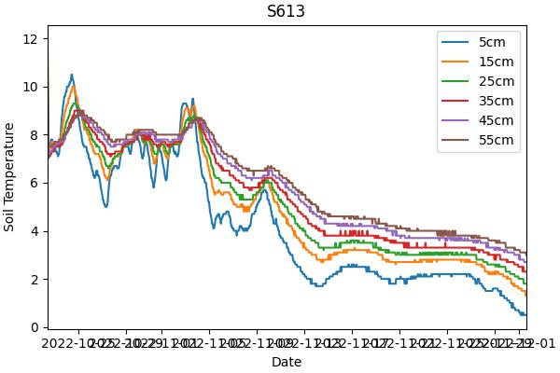



Slide 9
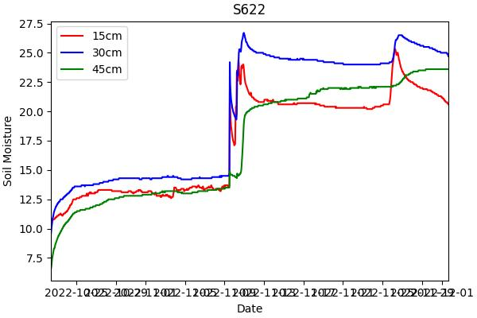
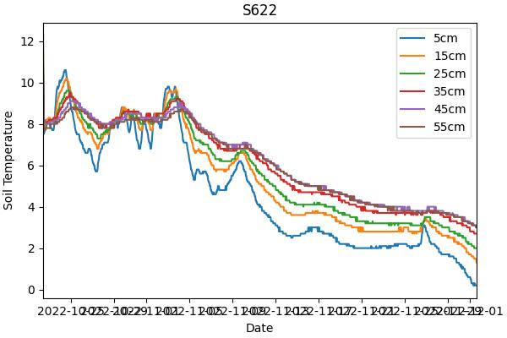

Slide 10
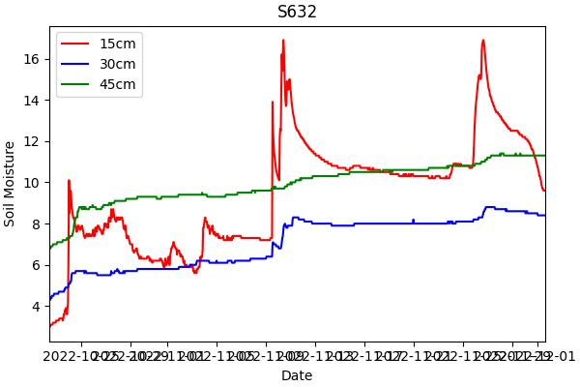
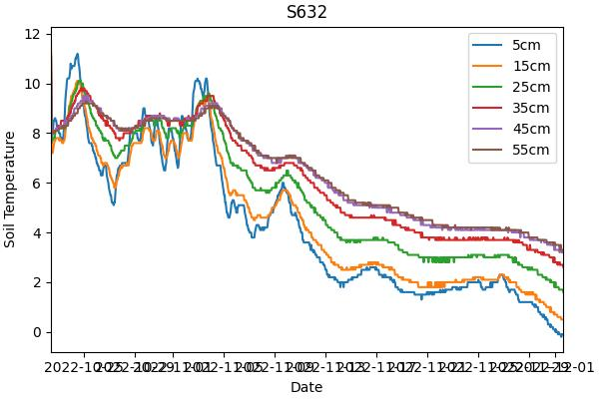





Slide 11



Slide 12


Slide 13
Summer 2022 LAI

Slide 14
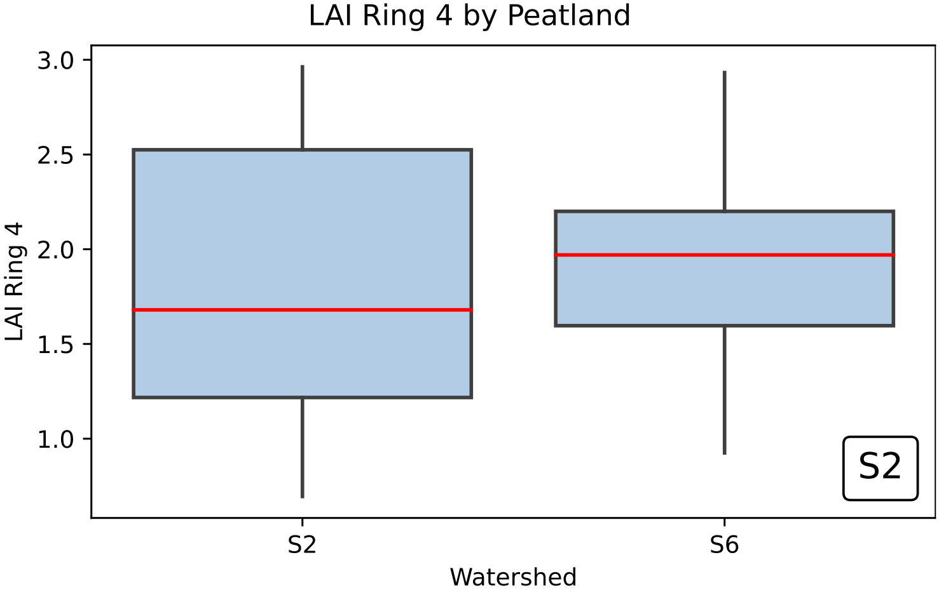

Slide 15
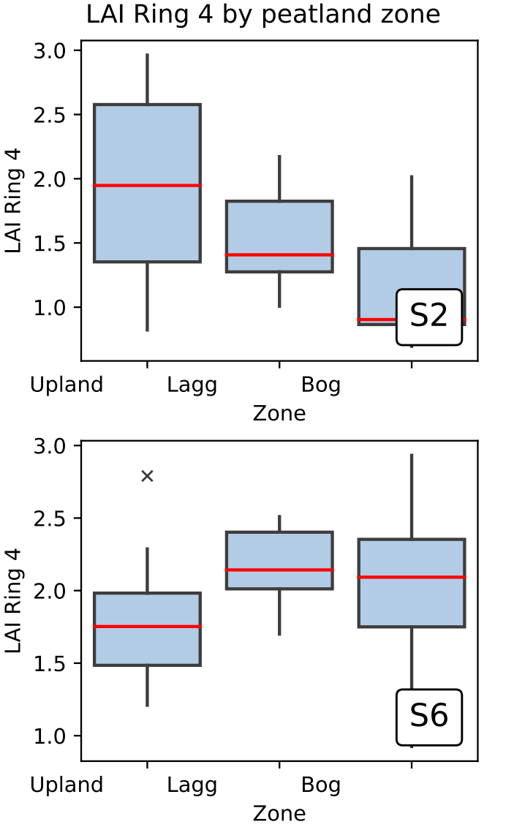
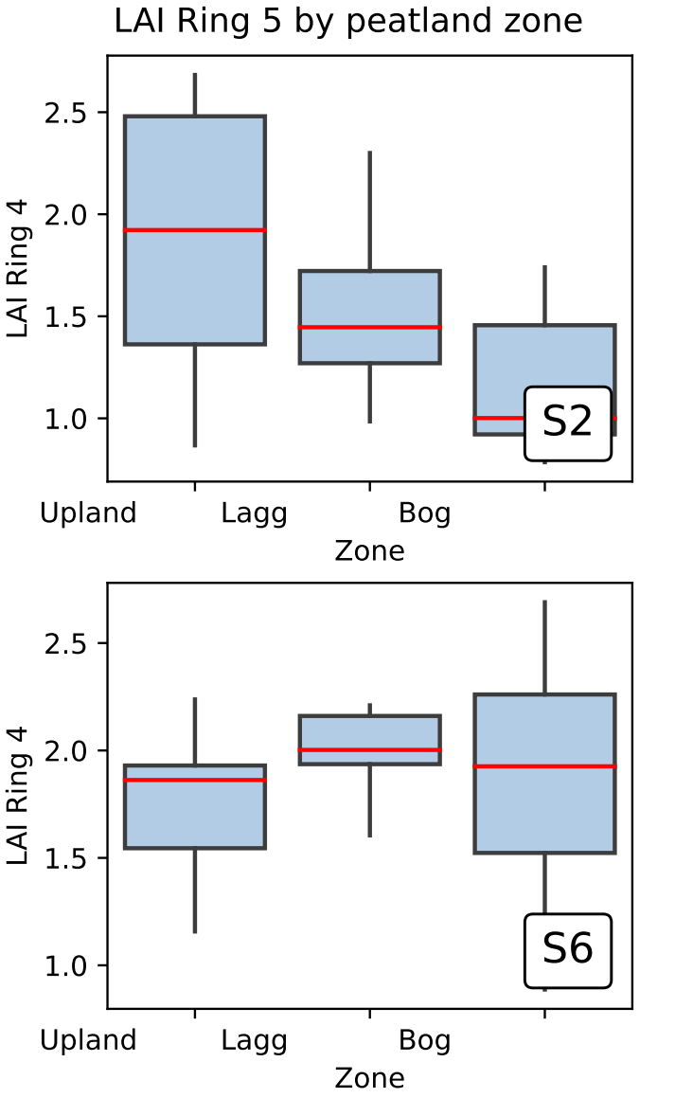
4 Ring
Zenith angles 0 – 60
ANOVA in S6 showed no significance (p = 0.357).
ANOVA in S2 found significant difference with p = 0.0197.
Tukey test showed difference between Upland and Bog values for LAI ring 4 (p = 0.021).
ANOVA showed no significant difference between the watersheds (p = 0.313).
5 Ring
Zenith angles 0 – 75

Slide 16
Winter 2022-2023 LAI

Slide 17
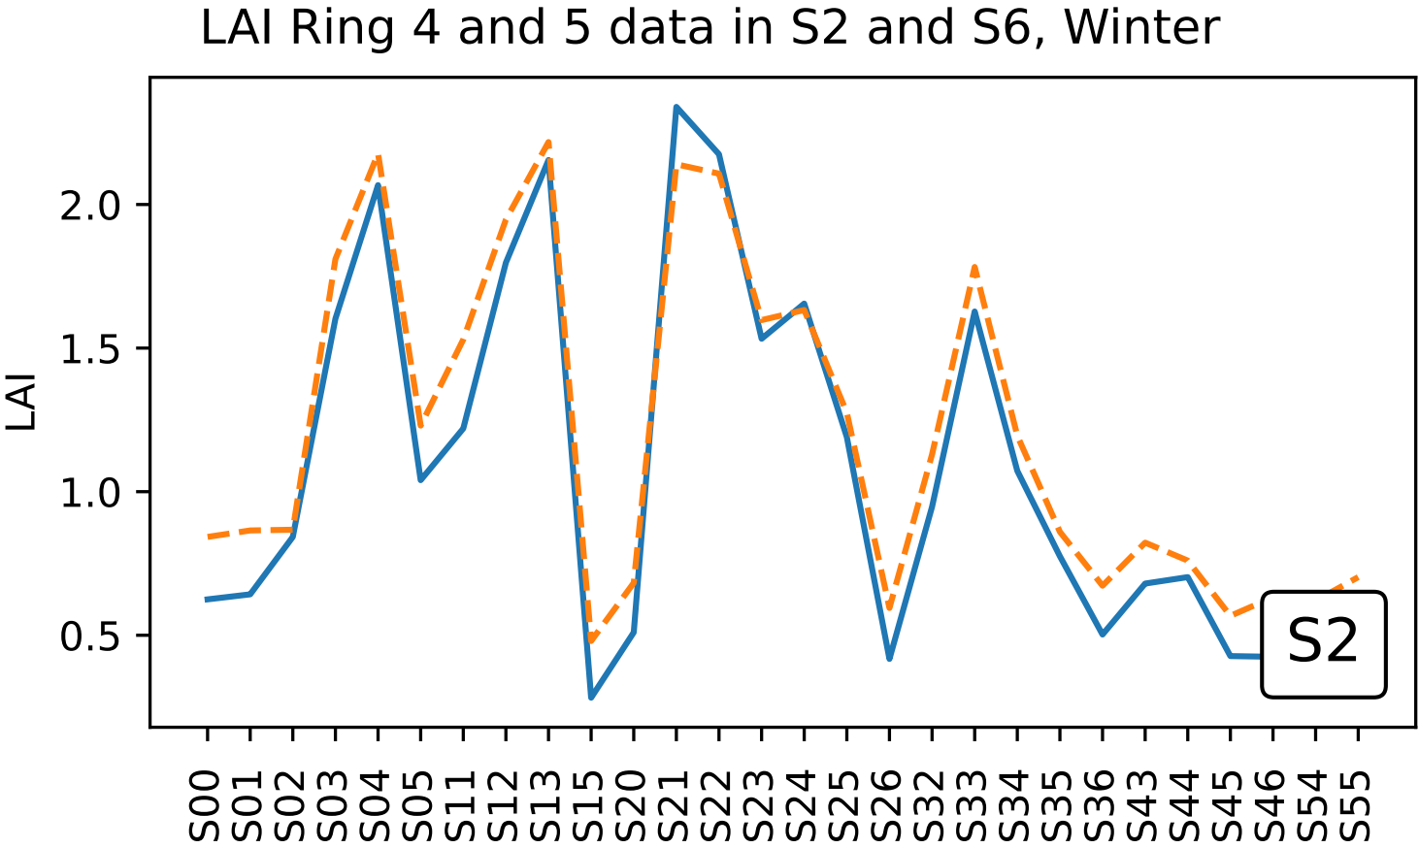

Slide 18
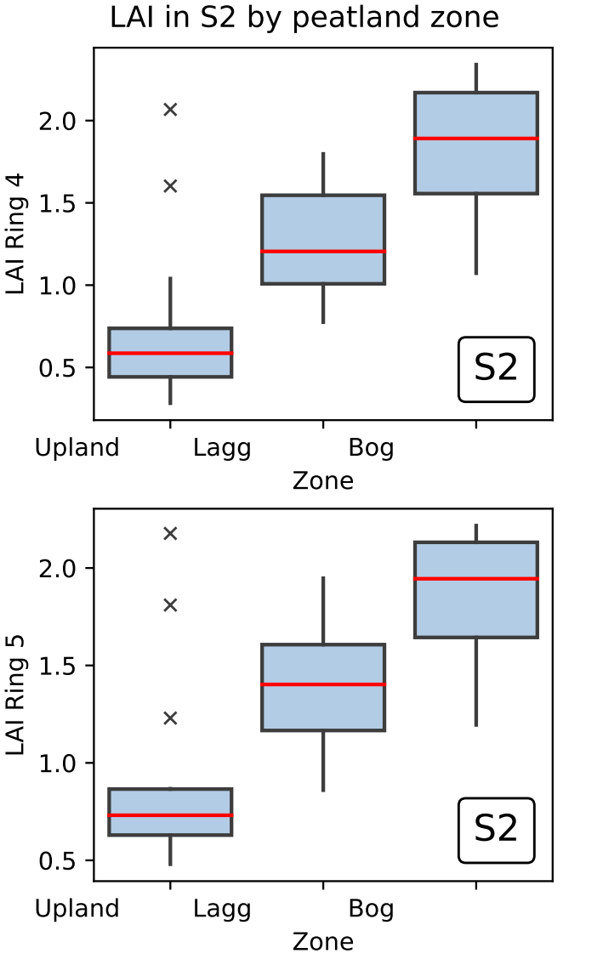
4 Ring
Zenith angles 0 – 60
5 Ring
Zenith angles 0-75
ANOVA in S2 found significant difference with p = 0.000168.
Tukey test showed difference between Upland and Bog at the 0.01 significance level (p = 0.000).
And Upland and Lagg at the 0.1 significance level (p = 0.062)

Slide 19
2022-2023 Snow Depth Data

Slide 20
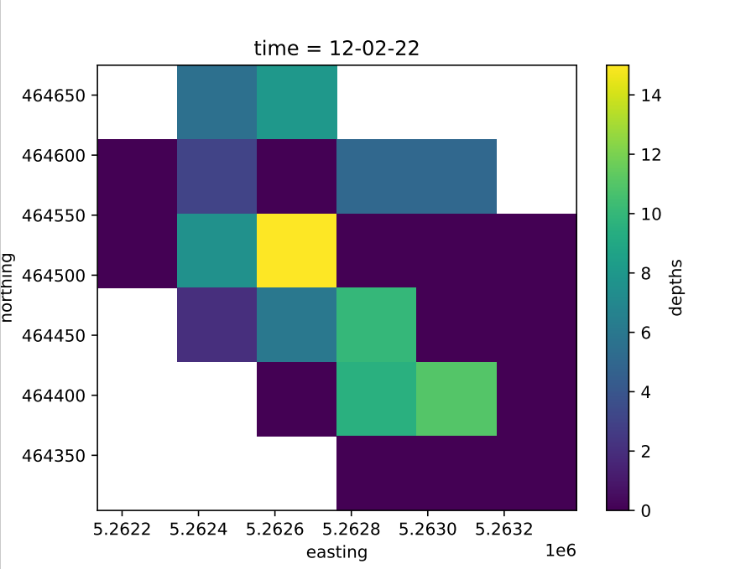
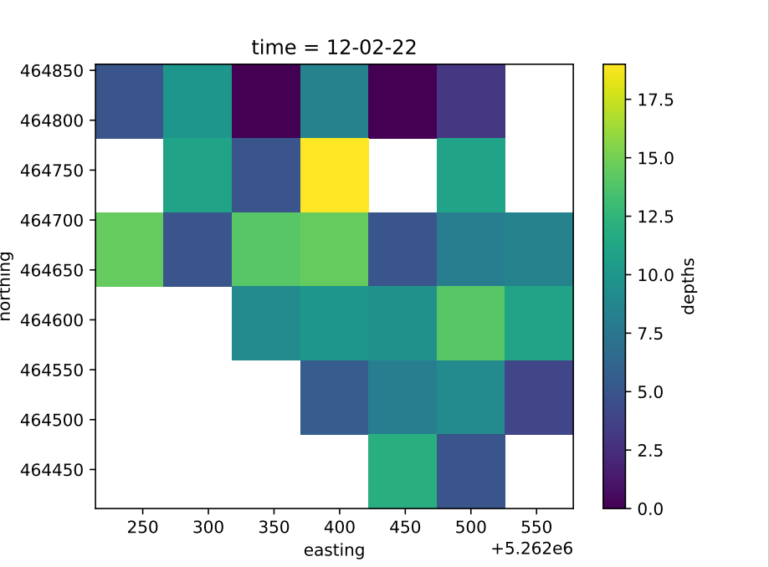






Slide 21
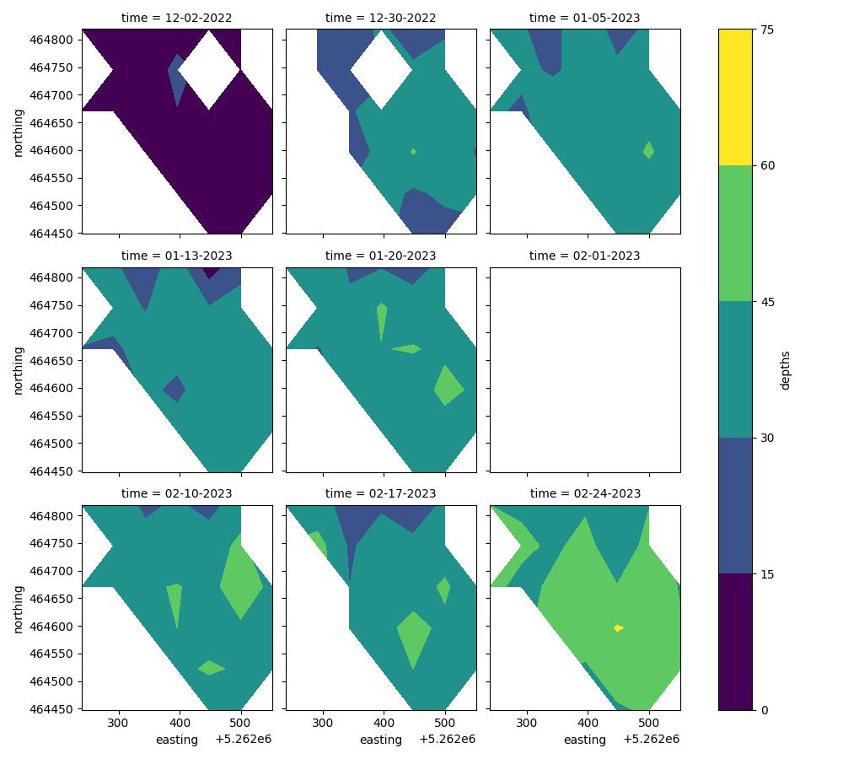

Slide 22
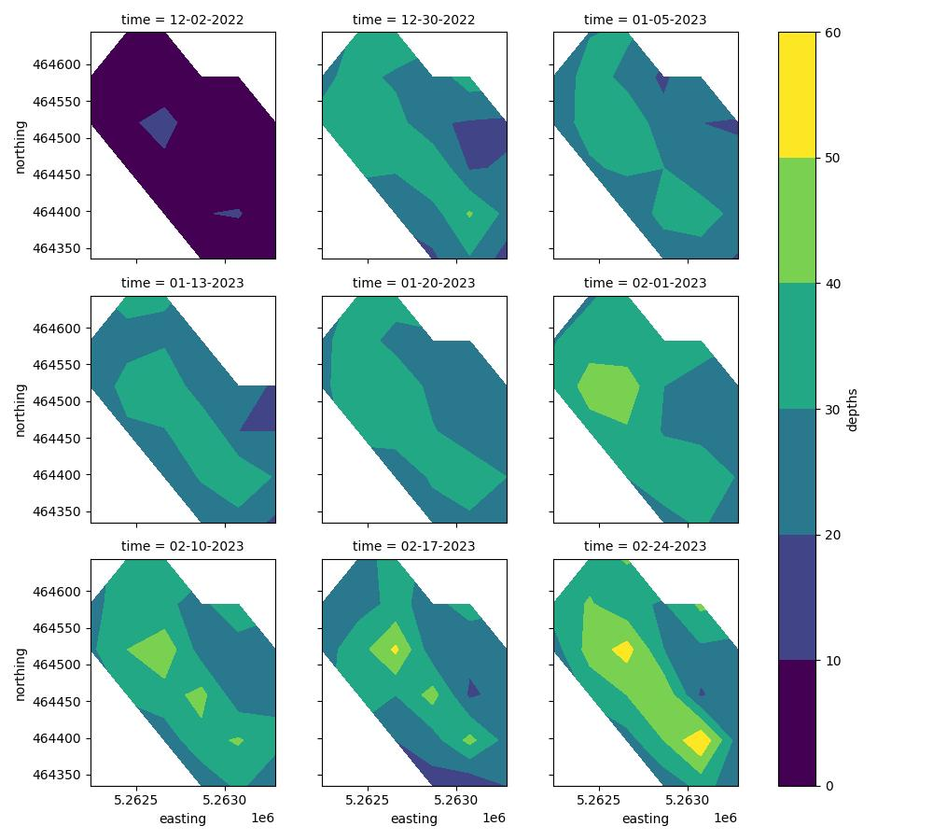

Slide 23
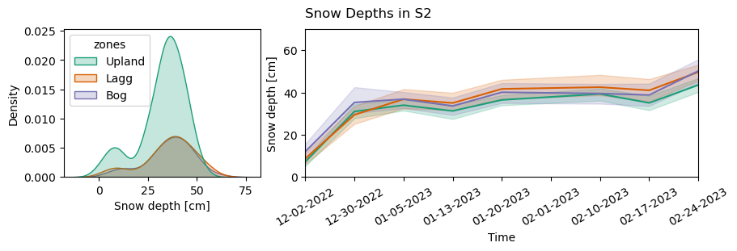
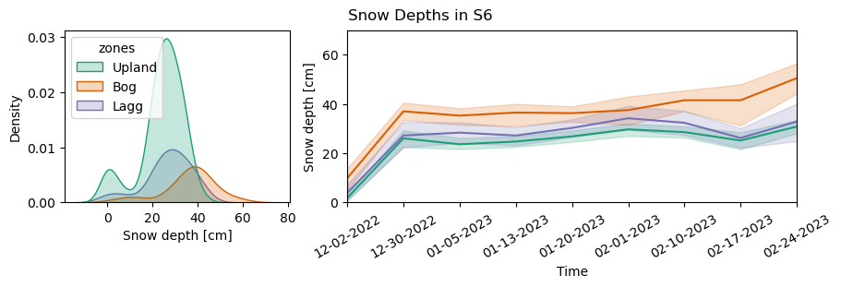

Slide 24
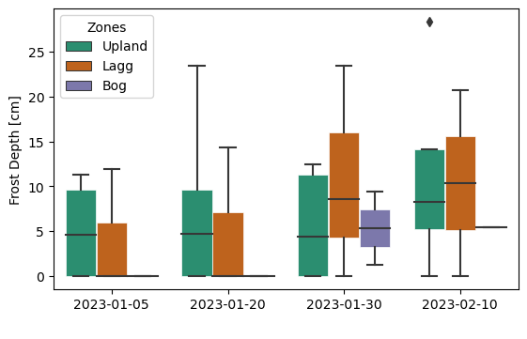

Slide 25
Winter 2022-2023 Snow/LAI Comparisons

Slide 26
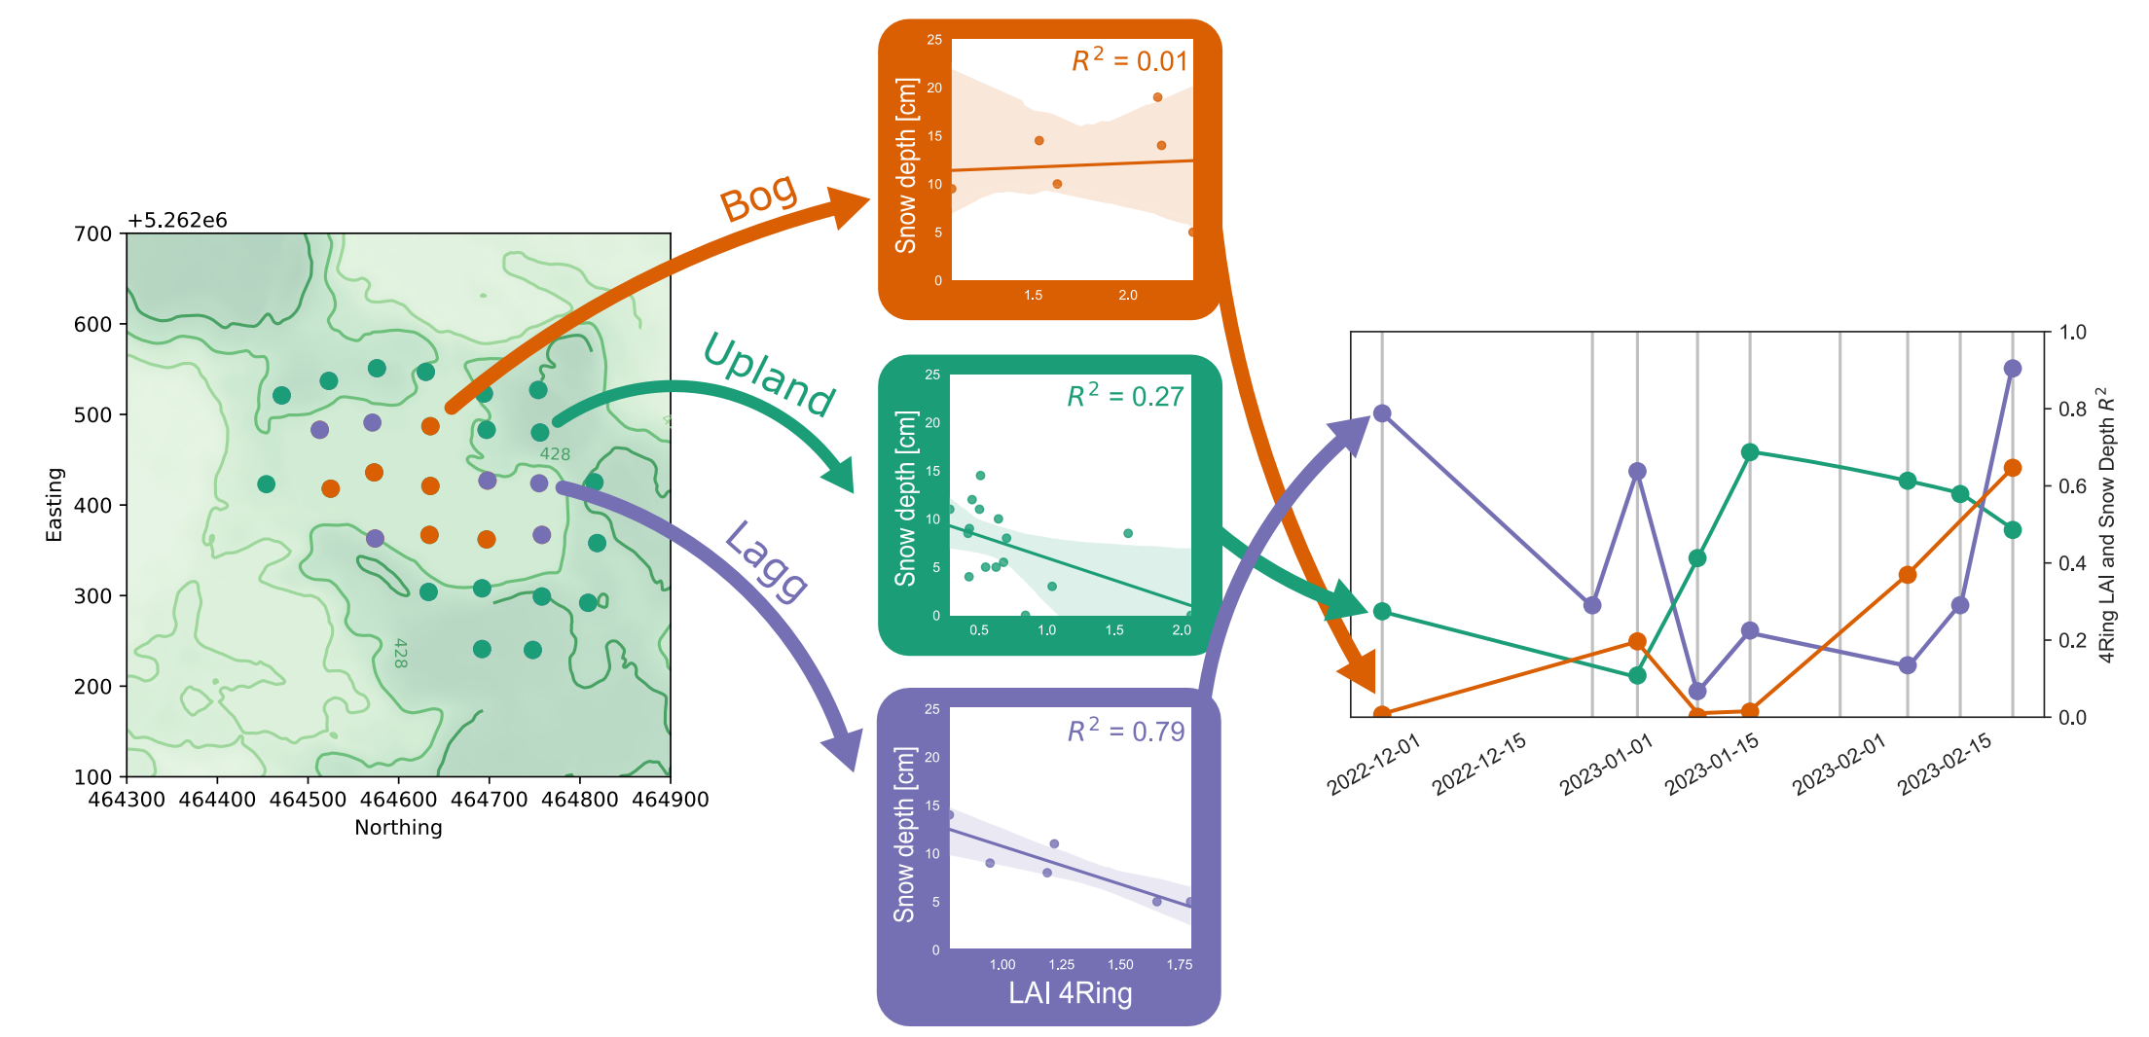

Slide 27
